Slide 1





Databases and MySQL: First Steps
MySQL, phpMyAdmin, MySQL Workbench, SQL
Svetlin Nakov
Inspiration Manager
www.nakov.com
Software University
http://softuni.bg

Slide 2
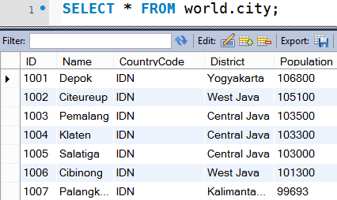

What is MySQL?
MySQL Database Server
MySQL is open-source DB server (RDBMS)
World's most-popular open-source database
Mostly used to power web sites and small apps
Supports concurrency, transactions (full ACID)
Stored procedures, views, triggers, partitioning
Support clustering and replication
Free and paid editions
Community Server, Enterprise, Cluster CGE

Slide 3
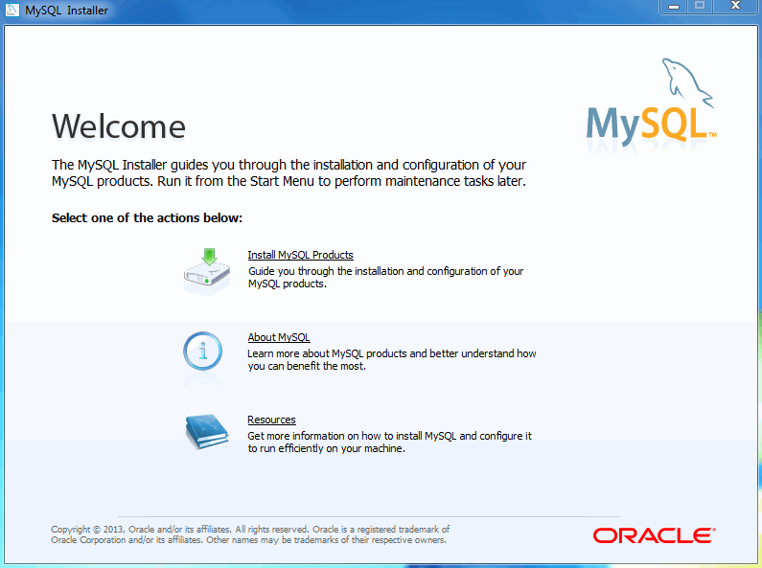
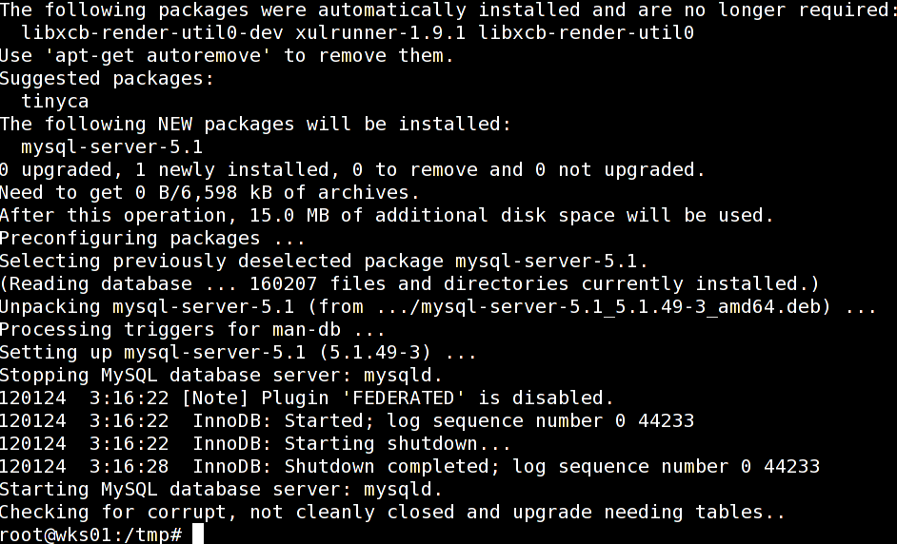
MySQL Community Server
MySQL Community Server
The free open-source MySQL edition
Windows:
Pre-packaged installer available from http://dev.mysql.com/downloads/mysql/
Linux:
Available through the package managers
E.g. apt-get install mysql-server, yum install mysql-server

Slide 4

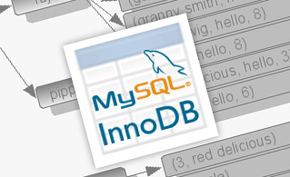
MySQL Storage Engines
MyISAM
Fast, non-transactional → unreliable, forget it!
InnoDB
Fully ACID transactional, highly reliable
Recommended for most applications
Memory
Ultra-fast, non-persistent
CSV
Stores the data in CSV (text) files

Slide 5
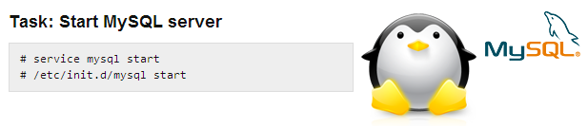
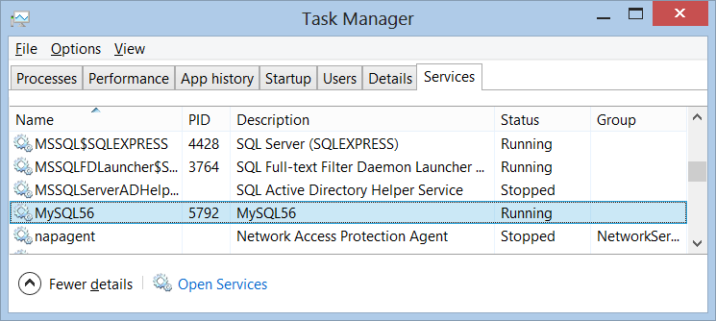
MySQL Services, Start, Stop
MySQL Services
Just one service:
MySQL56 (in Windows)
Starting:
net start MySQL56
sudo service mysql start
Stopping:
net stop MySQL56
sudo service mysql stop

Slide 6
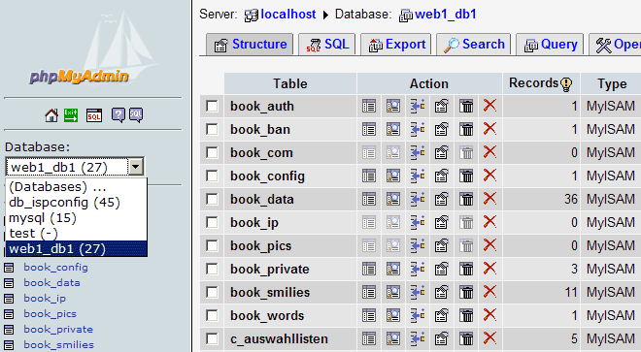
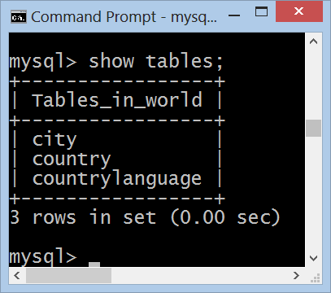


MySQL Administration Tools
Console Client, MySQL Workbench, phpMyAdmin

Slide 7
Authentication and Login
MySQL uses traditional username / password authentication
The administrator's user is: root
The default password is specified during the installation process
Connecting through the console client
mysql –u root -p
use world;
select * from city limit 100;

Slide 8
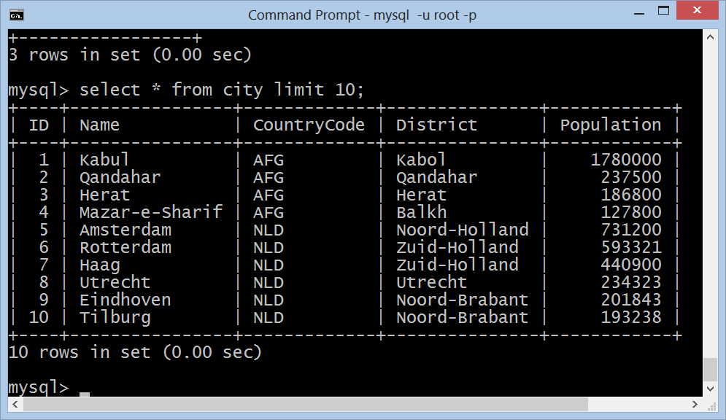
MySQL Console Client
Live Demo

Slide 9
phpMyAdmin Tool
phpMyAdmin: Web-based open-source MySQL admin tool

Slide 10
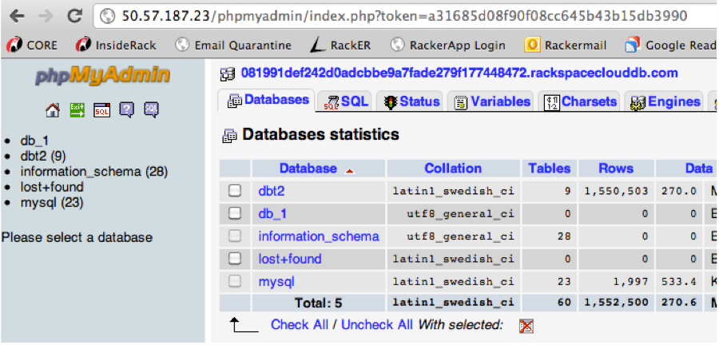
phpMyAdmin
Live Demo

Slide 11
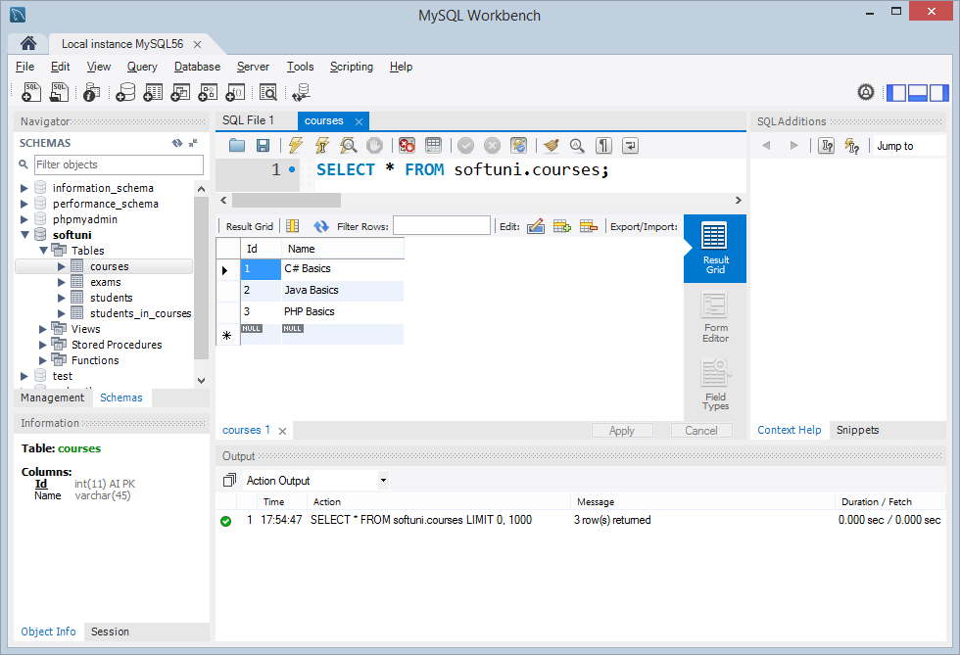
MySQL Workbench
MySQL Workbench is free open-source GUI administration tool for MySQL
Execute SQL queries
Browse / edit table data
Create / modify relational schema
DB design (E/R diagrams)
Forward / reverse engineering
Visualize query plan

Slide 12
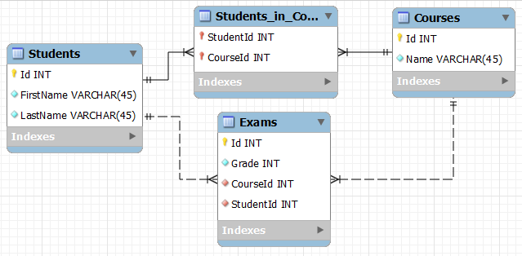
E/R Diagrams

Slide 13
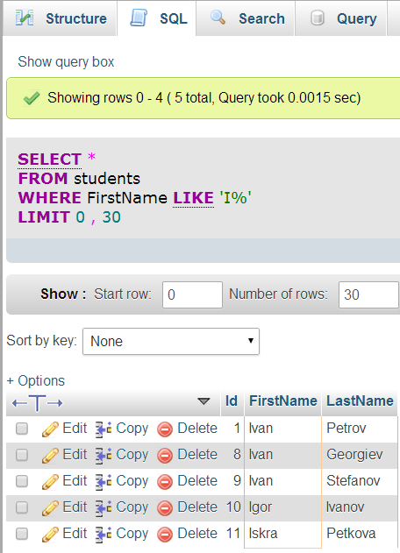




SQL Language
SELECT
WHERE (filtering)
JOIN (joining tables)
GROUP BY (grouping)
INSERT
UPDATE
DELETE

Slide 14
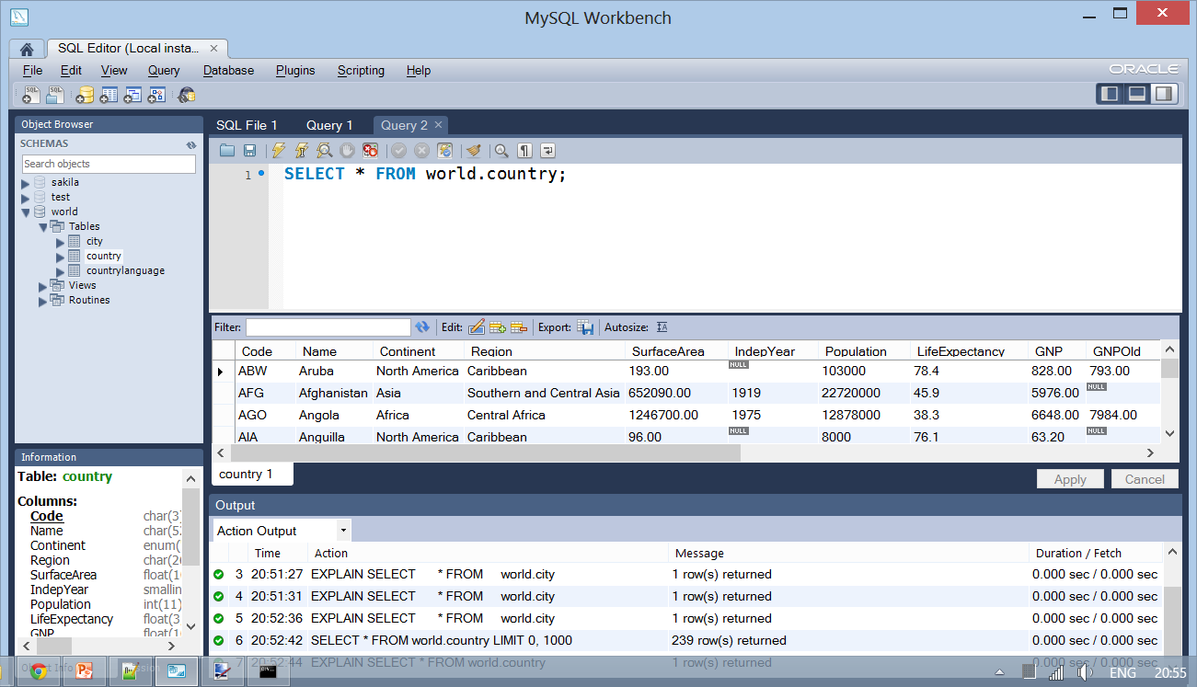
MySQL Workbench
Live Demo

Slide 15
Databases and MySQL
http://softuni.bg/SoftUniConf

Slide 16


Summary
TODO
PHP & MySQL

Slide 17

License
This course (slides, examples, demos, videos, homework, etc.) is licensed under the "Creative Commons Attribution-NonCommercial-ShareAlike 4.0 International" license
Attribution: this work may contain portions from
"PHP Manual" by The PHP Group under CC-BY license
"PHP and MySQL Web Development" course by Telerik Academy under CC-BY-NC-SA license

Slide 18





Free Trainings @ Software University
Software University Foundation – softuni.org
Software University – High-Quality Education, Profession and Job for Software Developers
softuni.bg
Software University @ Facebook
facebook.com/SoftwareUniversity
Software University @ YouTube
youtube.com/SoftwareUniversity
Software University Forums – forum.softuni.bg

